Slide 1
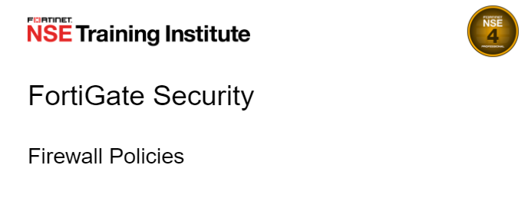
Notes:
Goal
Anyone can deliver Presentation
Demonstrate Fortinet is a Safe Bet
For Security
For Secure LAN Edge
We Are
Secure, simple to deploy, Smart systems, Great Support, single pane of glass

Slide 2
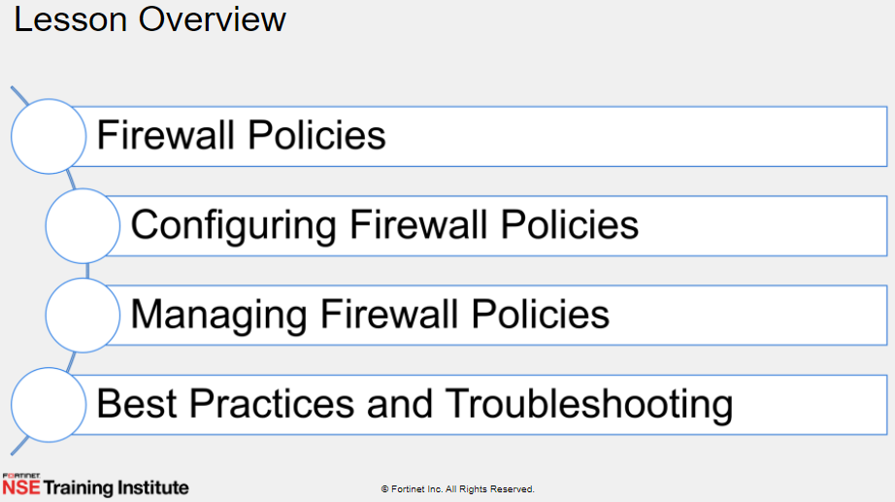

Slide 3
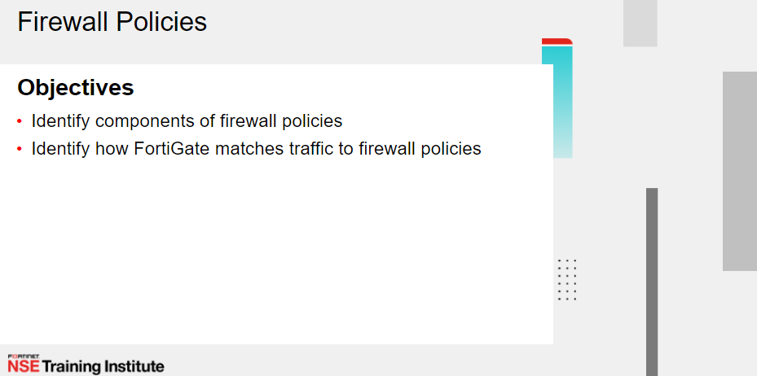

Slide 4
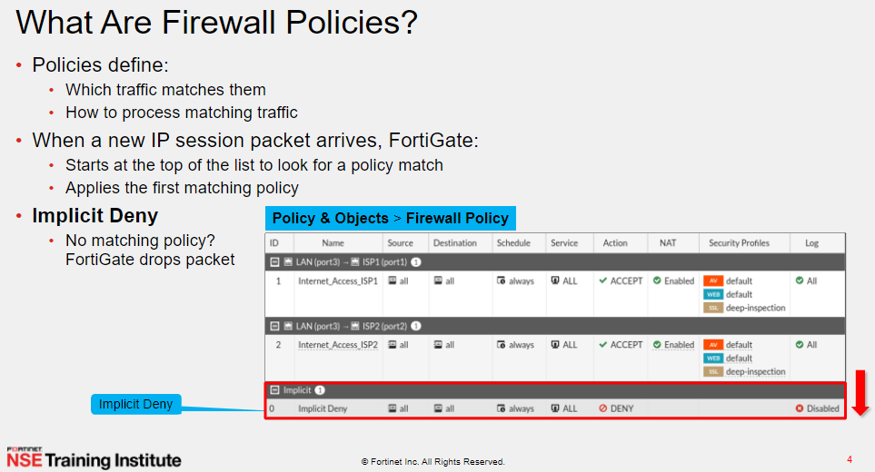

Notes:
https://docs.fortinet.com/document/fortigate/7.2.5/administration-guide/656084/firewall-policy#FirewallPolicyParameters

Slide 5
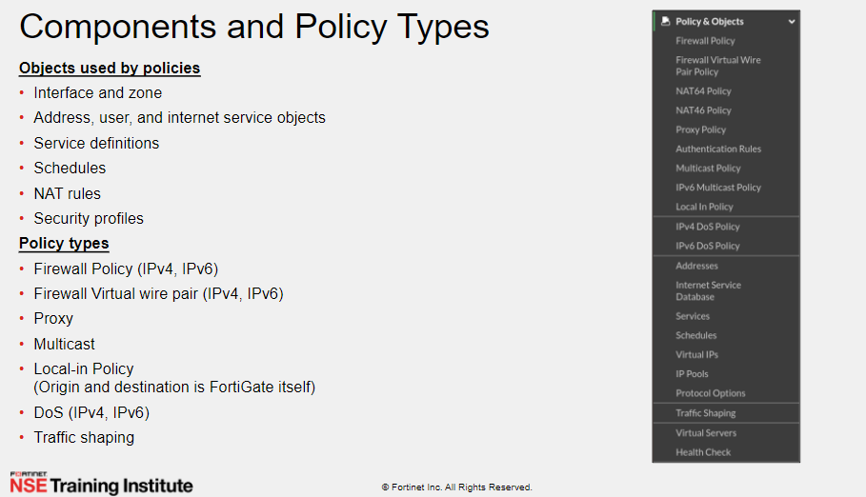


Slide 6
IP rule based FW vs interface / Zone based FW
Ip rule based FW : the policy paraments is ip source / destination , services / application
Zone Based FW : the policy paraments is , incoming / outgoing interface , ip source / destination , services / application

Slide 7
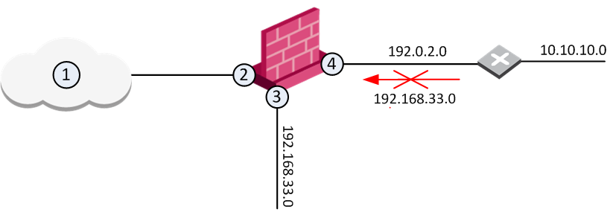
IP rule based FW and preventing IP Spoofing
IP spoofing replaces the untrusted source IP address with a fake, trusted one, to hijack connections to your network. Attackers use IP spoofing to send malware and bots to your protected network, to execute DoS attacks, or to gain unauthorized access.
Anti-Spoofing detects if a packet with an IP address that is behind a certain interface, arrives from a different interface. For example, if a packet from an external network has an internal IP address, Anti-Spoofing blocks that packet.
Anti-Spoofing makes sure that:
All incoming packets to 2 come from the Internet (1)
All incoming packets to 3 come from 192.168.33.0
All incoming packets to 4 come from 192.0.2.0 or
10.10.10.0
If an incoming packet to B has a source IP address in network 192.168.33.0, the packet is blocked, because the source address is spoofed.

Slide 8
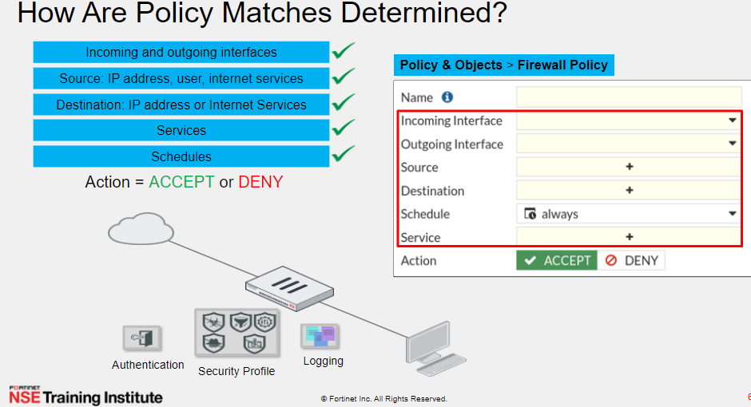

Notes:
https://docs.fortinet.com/document/fortigate/7.0.2/administration-guide/118003/policies

Slide 9
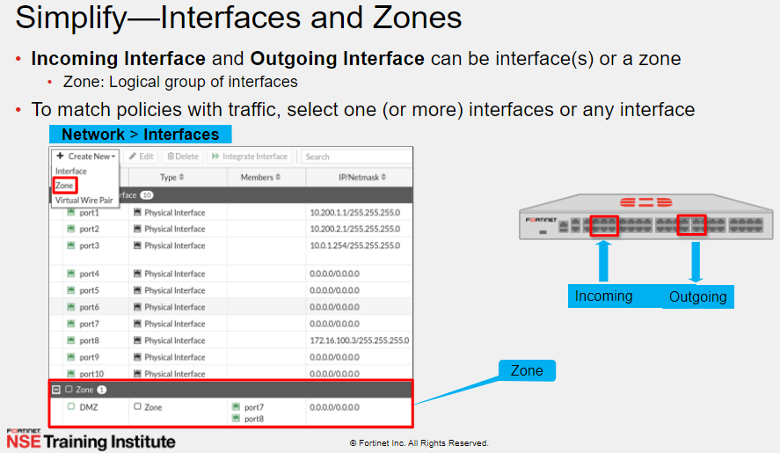

Slide 10
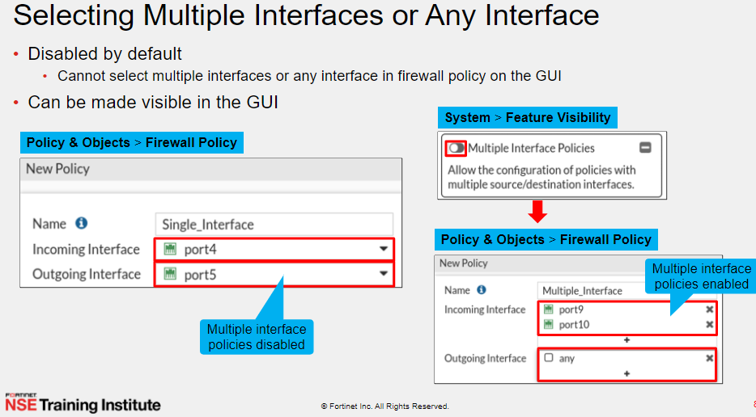
Notes:
https://www.reddit.com/r/fortinet/comments/k1al47/fortigate_multiple_interface_policy/

Slide 11
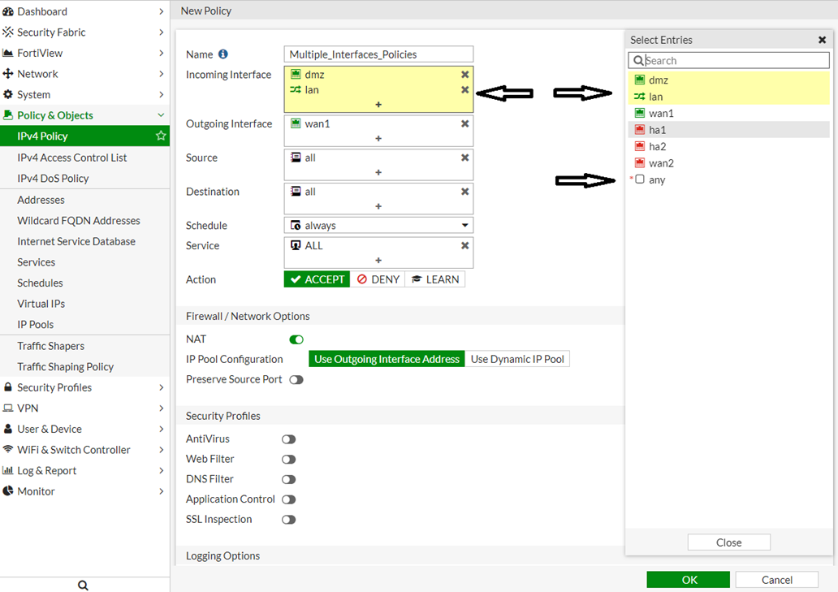

Slide 12
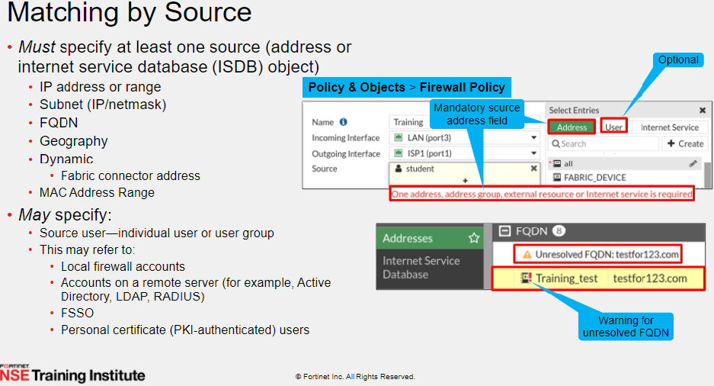

Slide 13
LAB
Windows machine inside VMware workstation should reach to internet
Create two policy to show them the matching : one for specific address another for all all
Specified address should create an object
Policy with zone instead of intereface
Policy lan for DMZ/WAN
See logs
See top traffic through

Slide 14
When does FortiGate generate traffic logs?

Slide 15
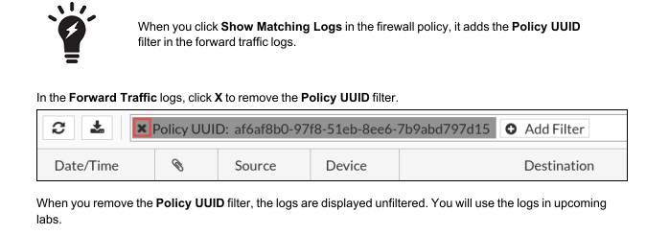
Show Matching Logs

Slide 16
Hit

Slide 17
LAB
Applying ISDB Objects as Destinations
FortiGate can match destination traffic using address objects or internet service database (ISDB) objects.
ISDB objects are predefined entries that FortiGuard regularly updates and contain a database of IP addresses, protocols, and port numbers that the most common internet services use.
You can use ISDB objects to allow or deny traffic to well-known internet destinations, without having to configure the IP addresses, protocols, or ports that those destinations use in the firewall policy.
Create two policy
- Name: block-facebook
- Name : Internet Access : DNS/HTTP/HTTPs

Slide 18
LAB
Virtual wire policy

Slide 19
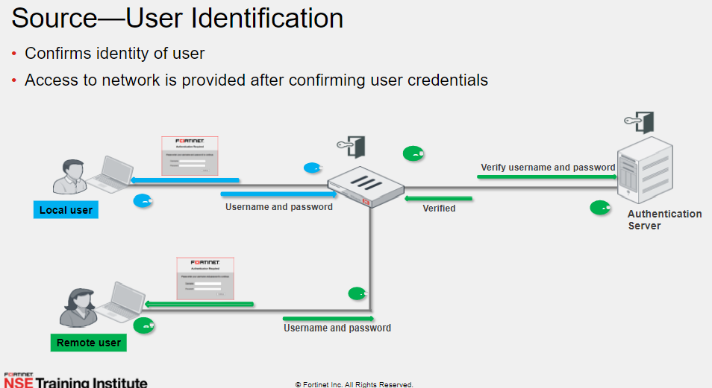

Slide 20
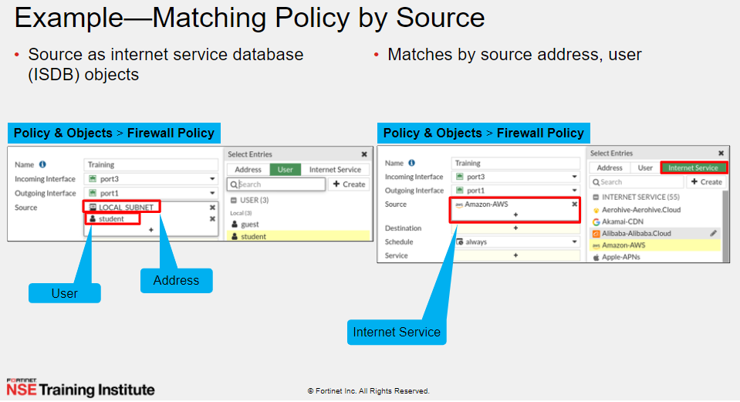
Notes:
Try with IP subnet or IP host
Try with Local host

Slide 21
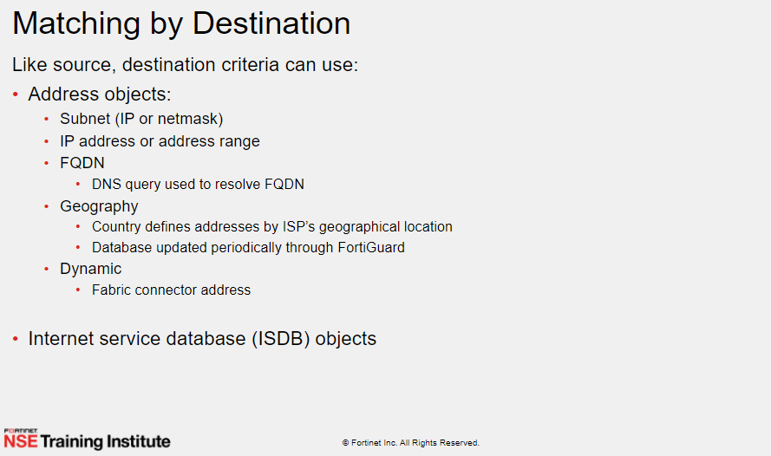

Slide 22
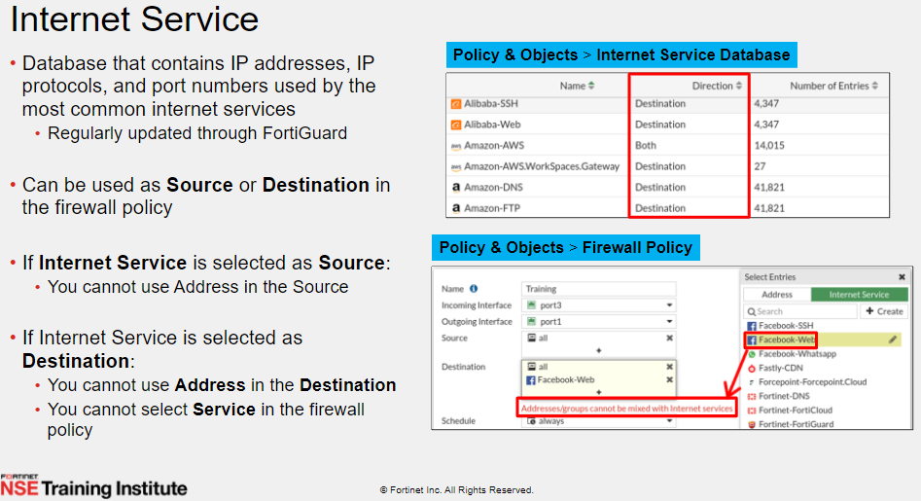
Notes:
https://docs.fortinet.com/document/fortigate/7.0.2/administration-guide/179236/using-internet-service-in-policy

Slide 23
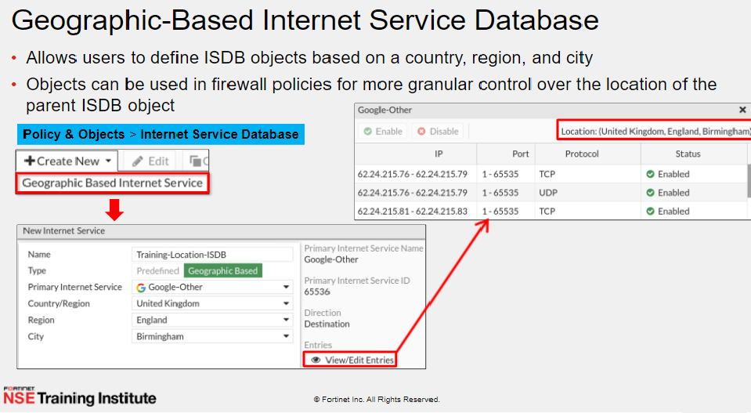

Slide 24
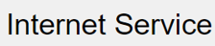
IP reputation filtering
get firewall internet-service-reputation 1
The five default reputation levels are: 1) Known malicious sites related to botnet servers, phishing sites, etc. 2) Sites providing high risk services, such as TOR, proxy, P2P, etc. 3) Unverified sites. 4) Reputable sites from social media, such as Facebook, Twitter, etc. 5) Known and verified safe sites, such as Gmail, Amazon, eBay, etc.
The default minimum reputation level in a policy is zero, meaning that the reputation filter is disabled.
The FortiGate gets the reputation information from ISDB, the Internet Service Database. Reputation minimums can be configured for either source or destinations in a policy, for example to ensure that users can only visit reputable websites, or to ensure that known malicious hosts may not access a server through a VIP.
Notes:
https://docs.fortinet.com/document/fortigate/7.0.2/administration-guide/179236/using-internet-service-in-policy
https://community.fortinet.com/t5/FortiGate/Technical-Tip-IP-reputation-in-policies-and-fallthrough/ta-p/193898

Slide 25
IP reputation filtering
get firewall internet-service-reputation 1
config firewall policy
edit 1
set srcintf “wan1"
set dstintf “LAN"
set dstaddr "all"
set reputation-minimum 3
set reputation-direction source
set action accept
set schedule "always"
set service "ALL"
set logtraffic all
set auto-asic-offload disable
set nat enable
next
End
Packets from the source IP address with reputation levels three, four, or five will be forwarded by this policy.
In a policy, if reputation-minimum is set, and the reputation-direction is destination, then the dstaddr, service, and internet-service options are removed from the policy.
If reputation-minimum is set, and the reputation-direction is source, then the srcaddr, and internet-service-src options are removed from the policy.
Notes:
https://docs.fortinet.com/document/fortigate/7.2.5/administration-guide/068937/ip-reputation-filtering
https://community.fortinet.com/t5/FortiGate/Technical-Tip-IP-reputation-in-policies-and-fallthrough/ta-p/193898

Slide 26
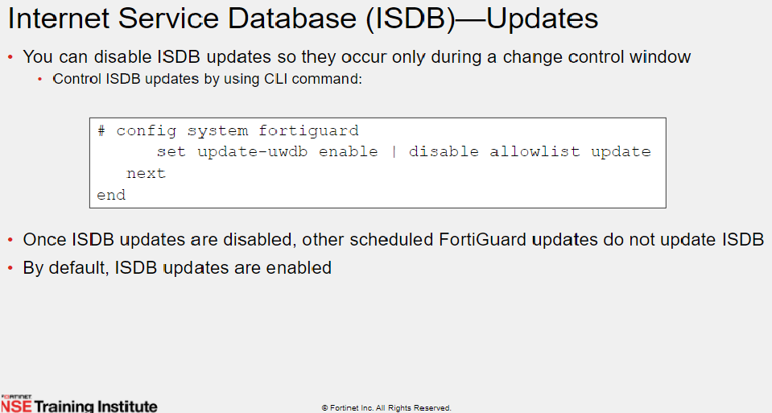

Slide 27
MAC addressed-based policies
FortiOS only supports the MAC address type as source address for policies in NAT mode VDOM. When you use the MAC address type in a policy as source address in NAT mode VDOM, IP address translation (NAT) is still performed according to the rules defined in the policy. The MAC address type only works for source address matching. It does not have any association with NAT actions.
DHCP monitor and revoke
Notes:
https://docs.fortinet.com/document/fortigate/7.0.2/administration-guide/407159/mac-addressed-based-policies

Slide 28
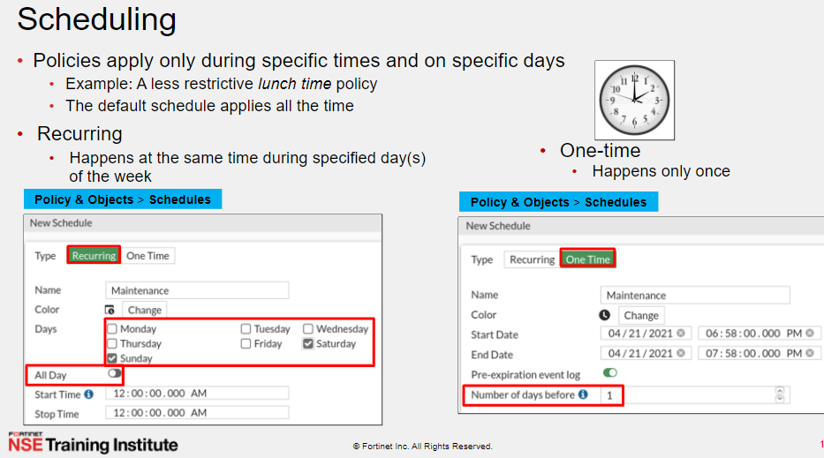

Slide 29
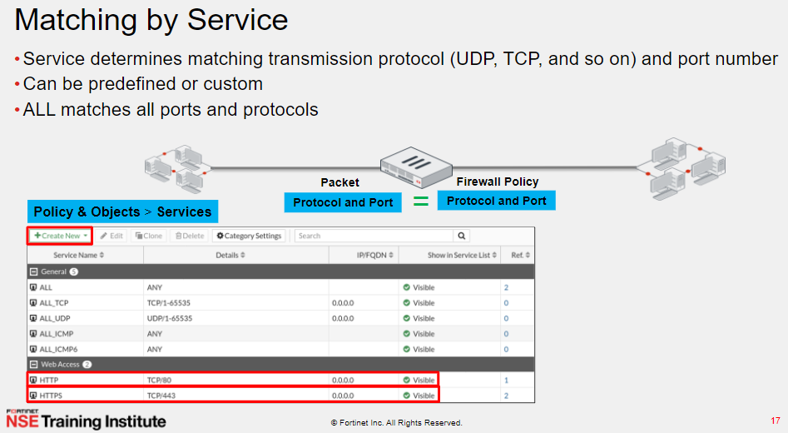

Slide 30
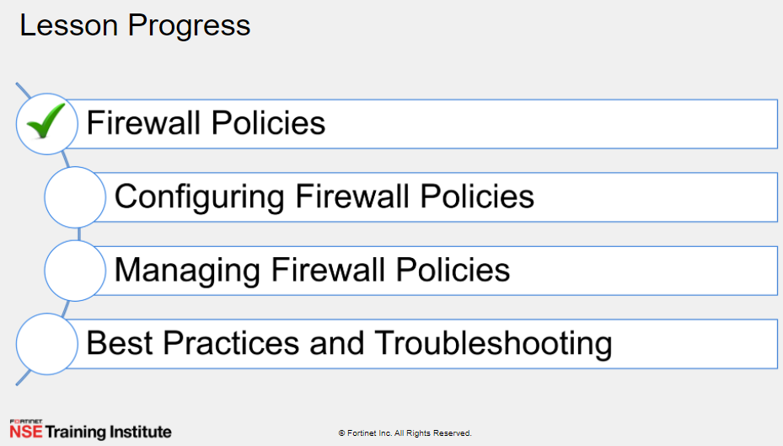

Slide 31
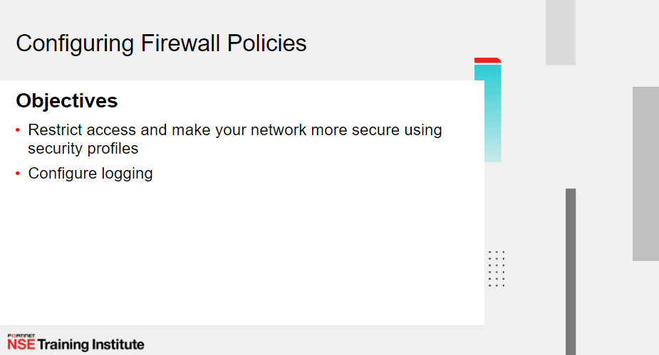

Slide 32
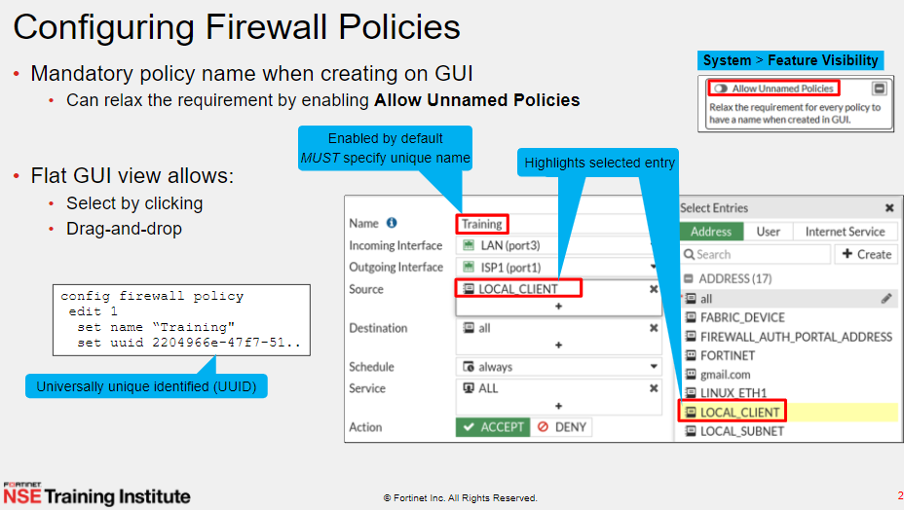

Slide 33
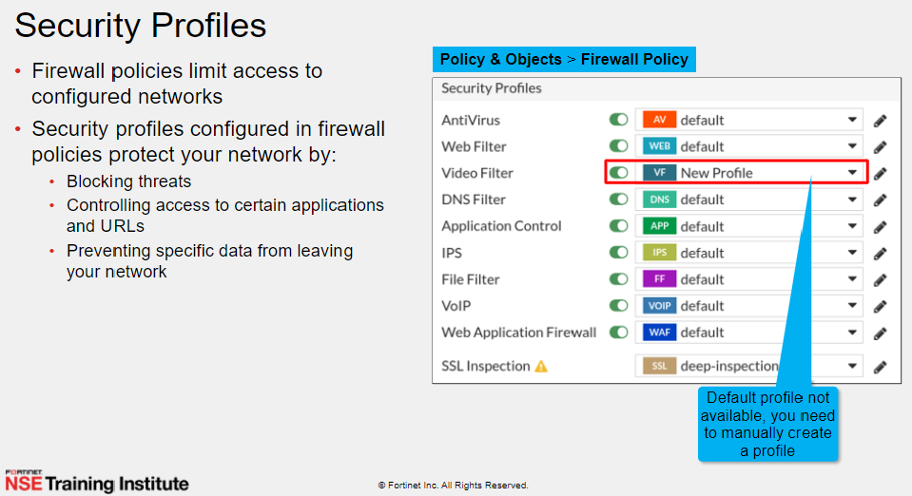

Slide 34
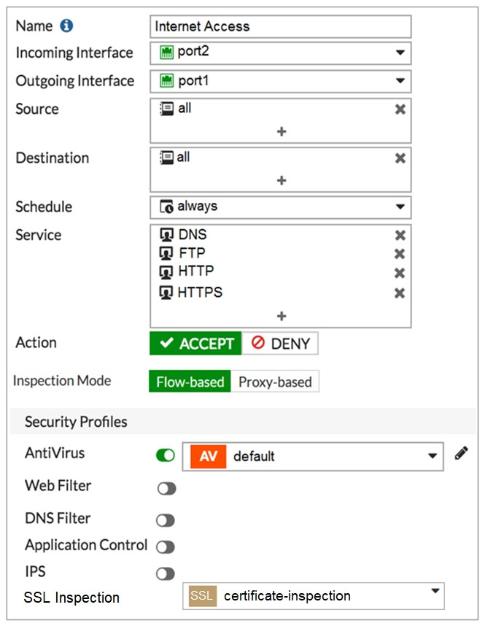
Security Profiles With policy based vs proxy based
Proxy
Proxy-based inspection involves buffering the traffic and
examining it as a whole before determining an action.
The process of having the whole of the data to analyze allow
this process to include more points of data to analyze
than the flow-based or DNS methods.
The advantage of a proxy-based method is that the inspection can be more thorough than the other methods, resulting in fewer false positive or negative results in the analysis of the data.

Slide 35
Security Profiles With policy based vs proxy based
Flow-based
The Flow-based inspection method examines the file as it passes through the FortiGate unit without any buffering. As each packet of the traffic arrives it is process and forwarded without waiting for the complete file or web page
The advantage of the flow-based method is that the user sees a faster response time for HTTP requests and there is less chance of a time-out error due to the server at the other end responding slowly.
The disadvantages of this method are that there is a higher probability of a false positive or negative in the analysis of the data and that a number of points of analysis that can be used in the proxy-based method are not available in the flow-based inspection method. There is also fewer actions available to choose from based on the categorization of the website by FortiGuard services.

Slide 36
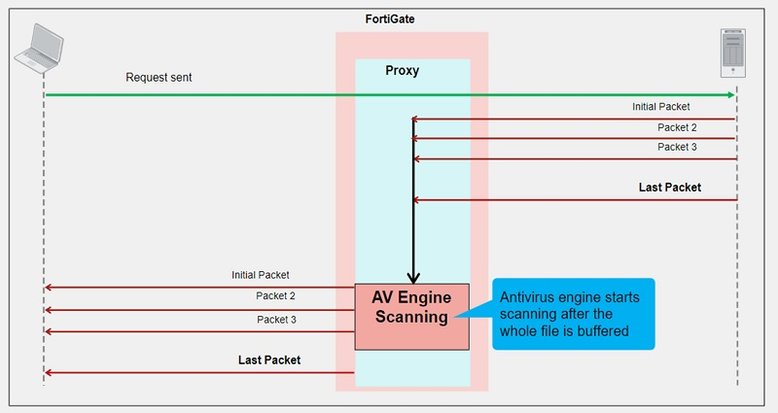
Security Profiles With policy based vs proxy based

Slide 37
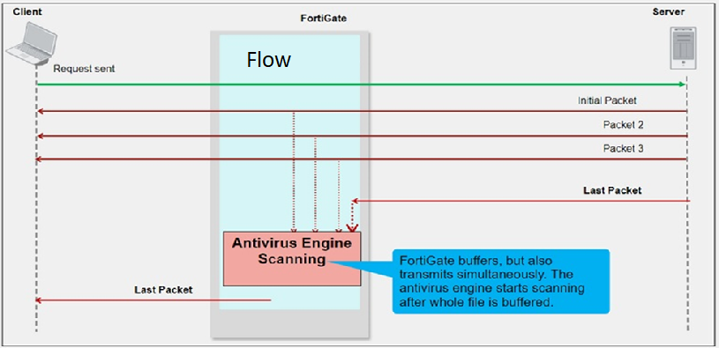
Security Profiles With policy based vs proxy based

Slide 38
Profile-based NGFW vs policy-based NGFW
Profile-based next-generation firewall (NGFW) mode is the traditional mode where you create a profile (antivirus, web filter, and so on) and then apply the profile to a policy.
In policy-based NGFW mode, you allow applications and URL categories to be used directly in security policies, without requiring web filter or application control profiles.
In policy-based mode Central NAT is always enabled. If no Central SNAT policy exists, you must create one
Enabling policy-based NGFW mode
To enable policy-based NGFW mode without VDOMs in the GUI:
Go to System > Settings.
In NGFW Mode, select Policy-based.
Click Apply.
CLI:
config system settings
set ngfw-mode policy-based
end
Notes:
https://docs.fortinet.com/document/fortigate/7.0.1/administration-guide/978598/profile-based-ngfw-vs-policy-based-ngfw

Slide 39
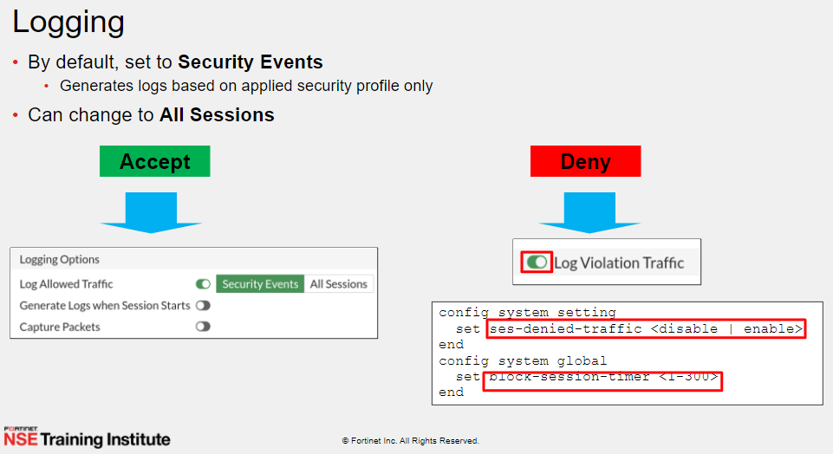

Slide 40
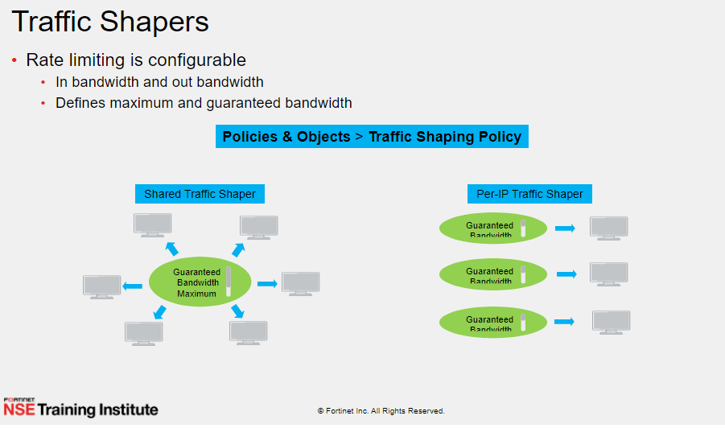

Slide 41
Traffic shaping policies
When traffic hits the firewall, the FortiGate will first look up a firewall policy, and then match a shaping policy. The matching traffic will apply a traffic shaper, class ID, or assign a DSCP DiffServ tag to the outgoing traffic.
Shared shaper : applied to traffic in the ingress-to-egress direction. For example, on traffic that egresses on the wan interface, the shaper is applied to upload or outbound traffic.
Reverse shaper : applied to traffic in the egress-to-ingress direction. For example, on traffic that egresses on the wan interface, the shaper is applied to download or inbound traffic.
Per-IP shaper : affect downloads and uploads. The allotted bandwidth applies to each individual IP.
Notes:
https://docs.fortinet.com/document/fortigate/7.4.1/administration-guide/673634/traffic-shaping-policies

Slide 42
LAB
Traffic shaping policy
Apply traffic shaping policy for http.https,web service,dns for 1M
Notes:
https://docs.fortinet.com/document/fortigate/7.4.1/administration-guide/673634/traffic-shaping-policies

Slide 43
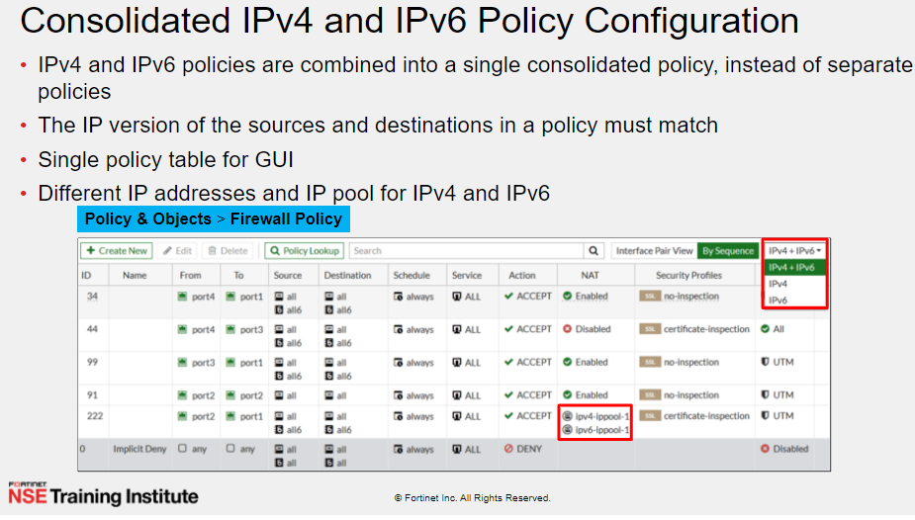

Slide 44
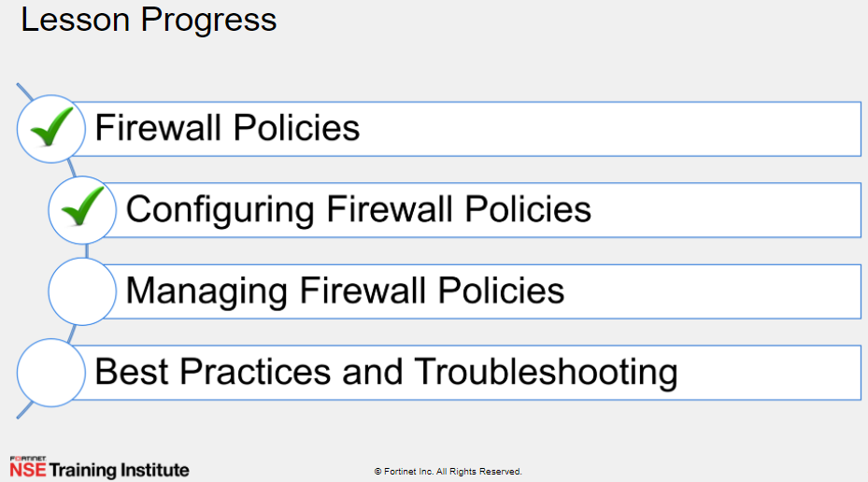

Slide 45
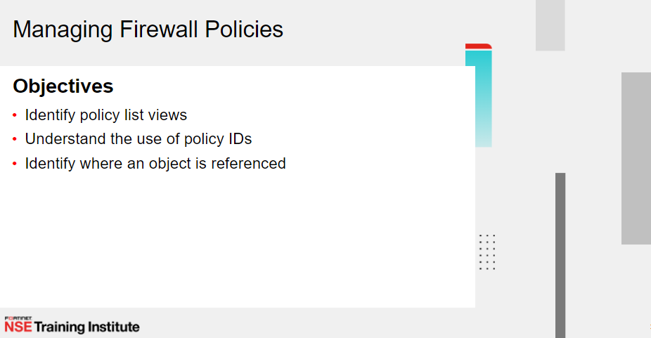


Slide 46
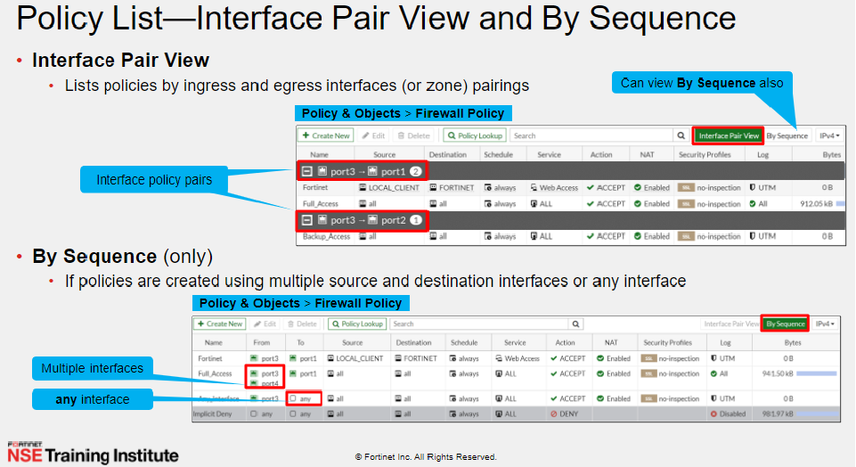

Slide 47
The FortiGate automatically changes the view on the policy list page to By Sequence whenever there is a policy containing any or multiple interfaces as the Source or Destination interface. If the Interface Pair View is grayed out, it is likely that one or more policies have used the any or multiple interfaces.

Slide 48
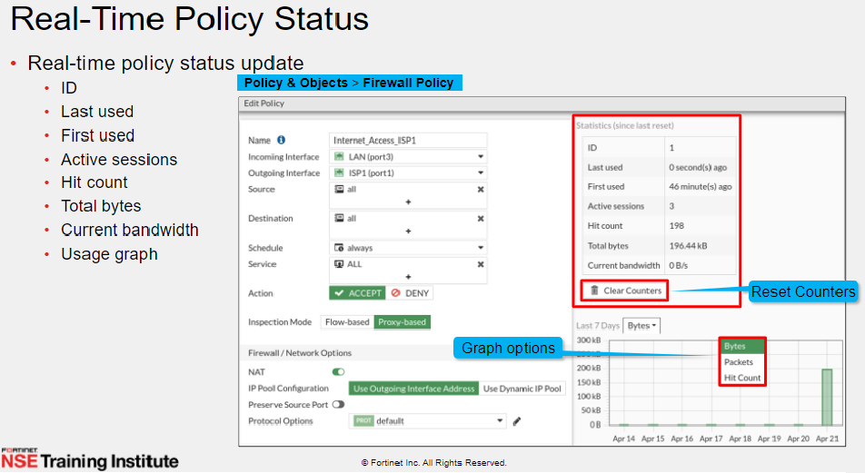

Slide 49
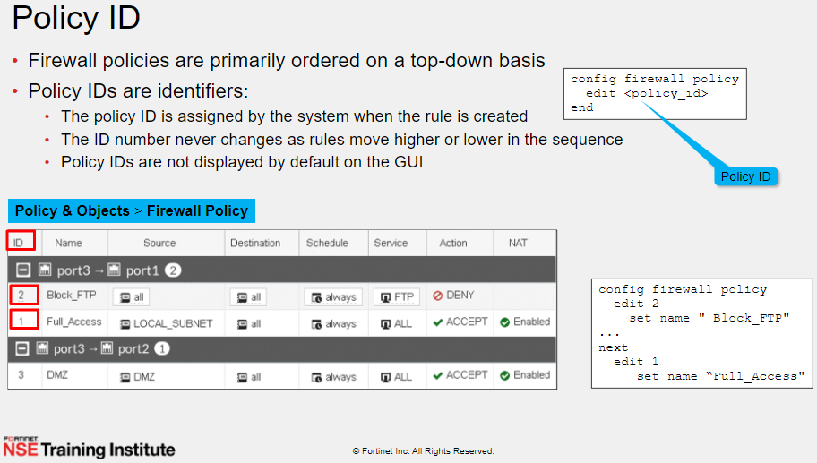

Slide 50
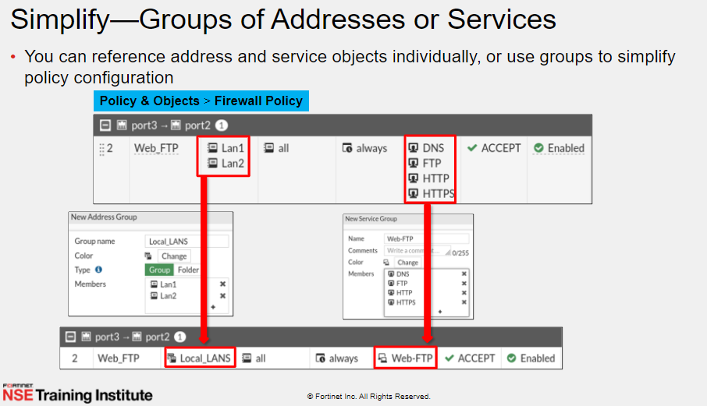

Slide 51
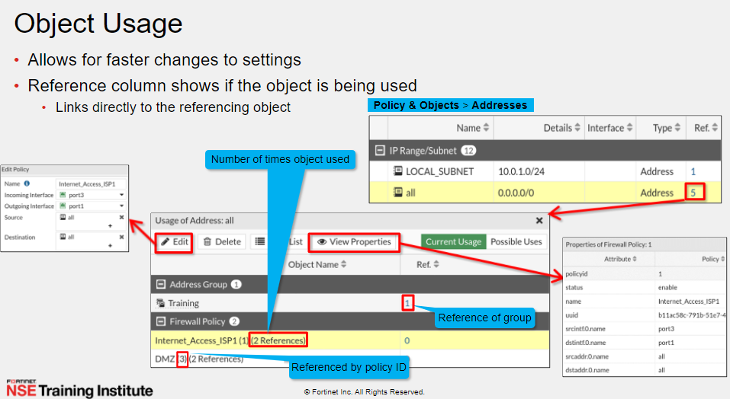

Slide 52
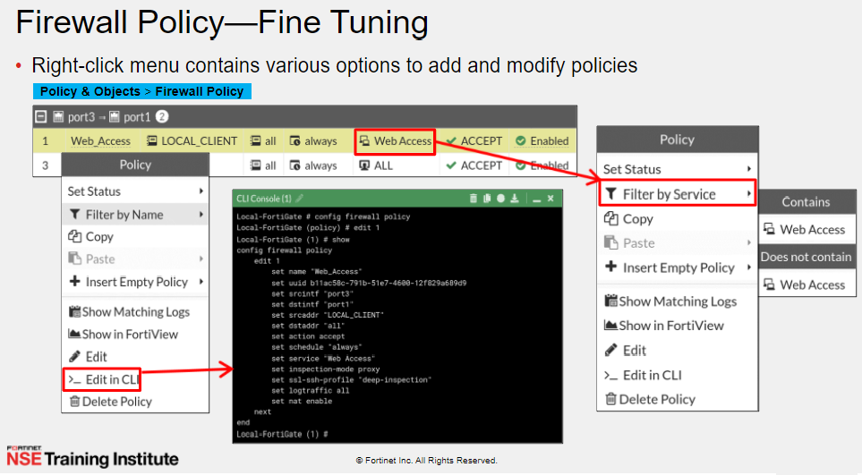

Slide 53
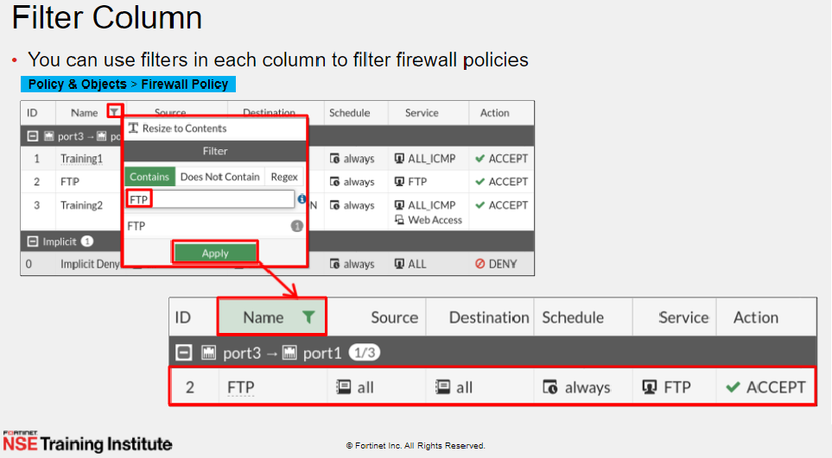

Slide 54
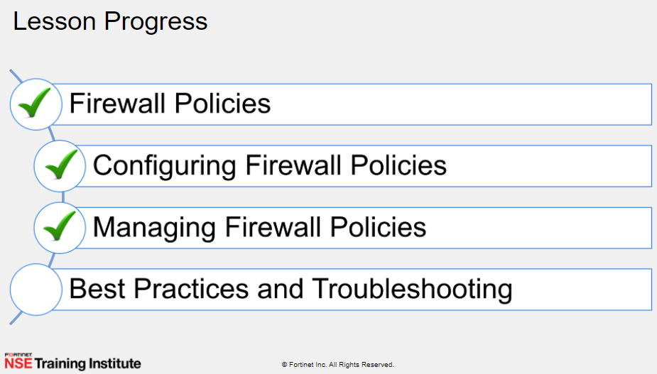

Slide 55
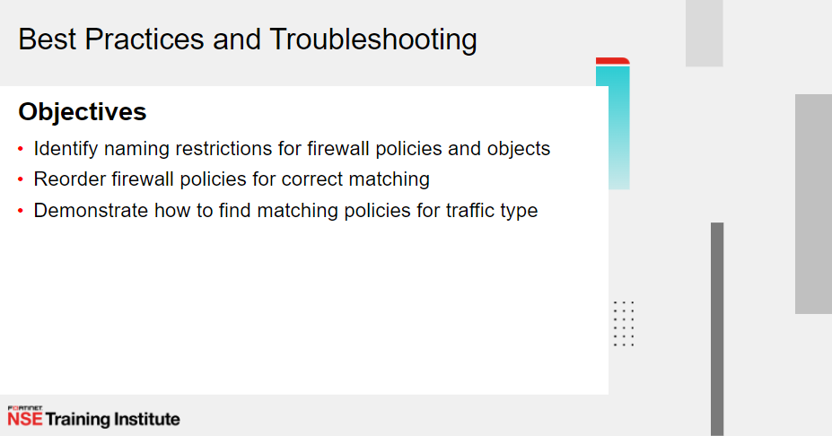

Slide 56
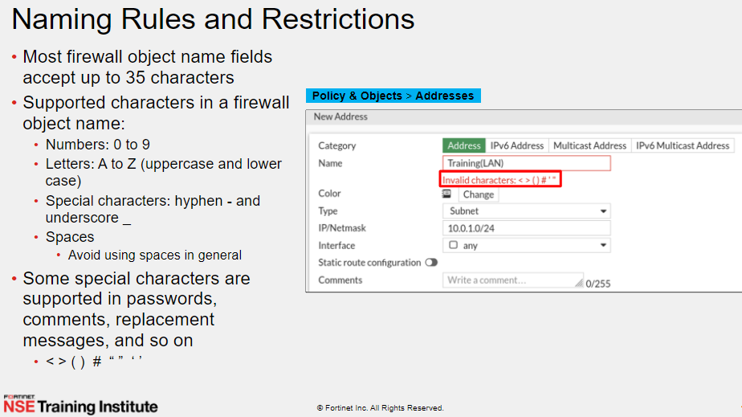

Slide 57
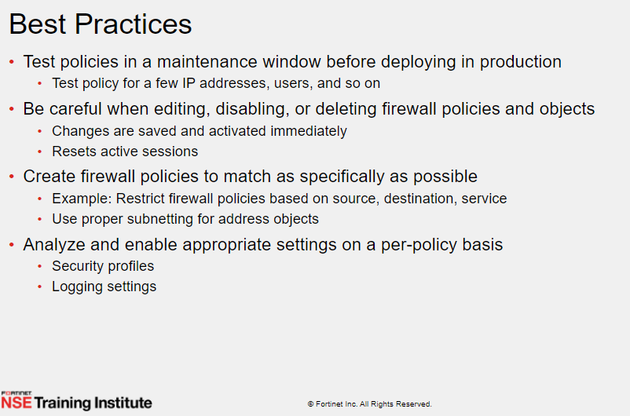

Slide 58
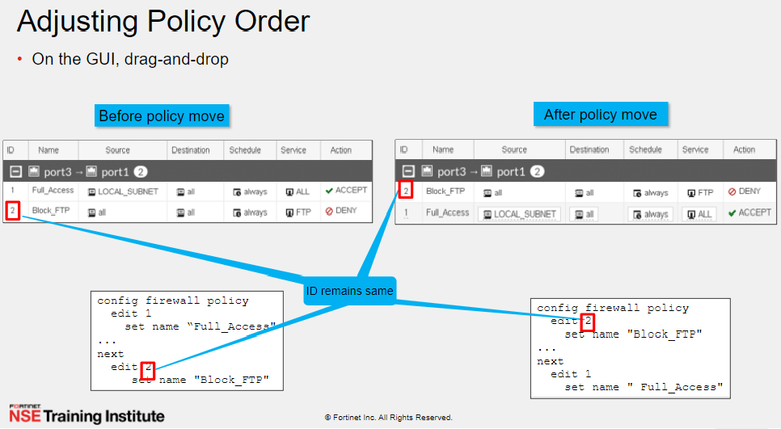

Slide 59
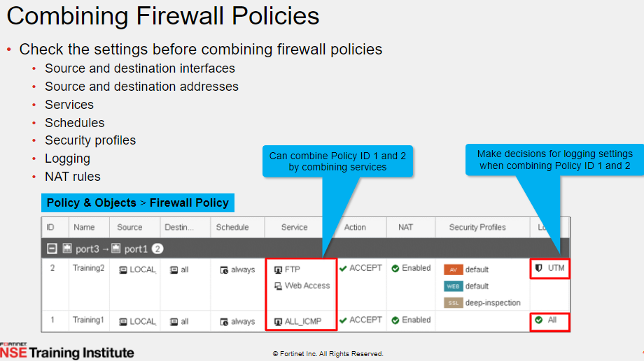

Slide 60
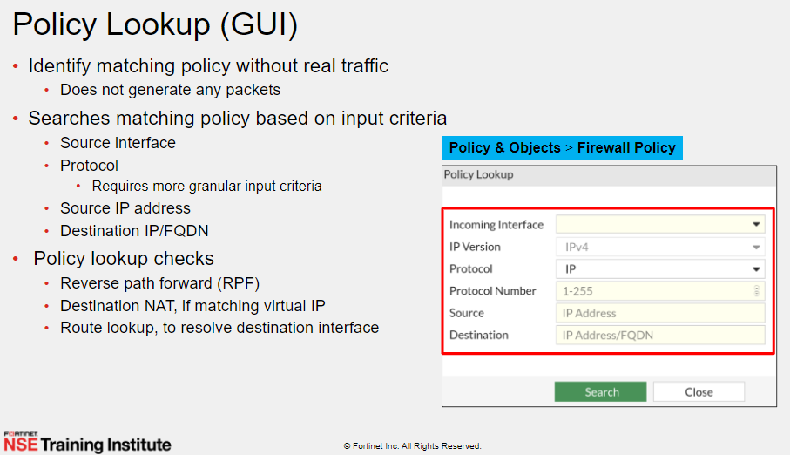
If the firewall policy status is set to disabled , the policy lookup skips the disabled policy and checks for the next matching policy the list
Notes:
If the firewall policy status is set to disabled , the policy lookup skips the disabled policy and checks for the next matching policy the list

Slide 61
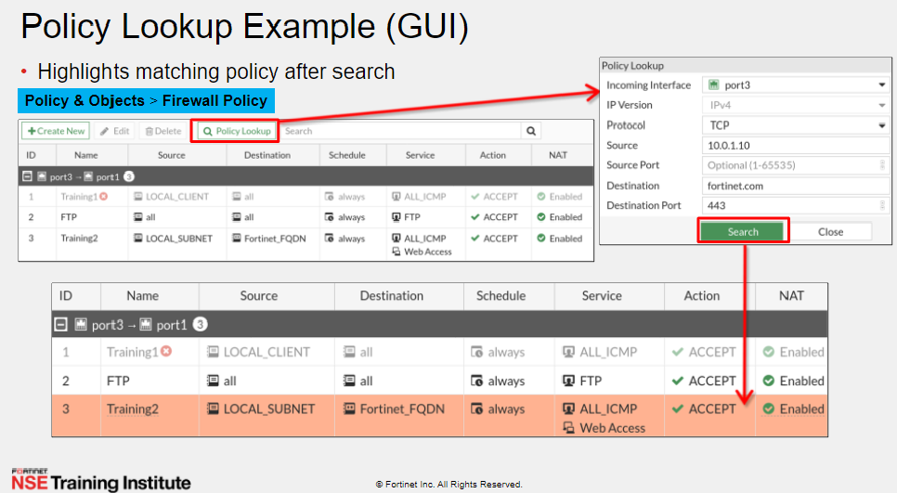
Notes:
Try with policy for all
Another policy specific

Slide 62
Traffic shaping
A FortiGate provides quality of service (QoS) by applying bandwidth limits and prioritization to network traffic. Traffic shaping is one technique used by the FortiGate to provide QoS.
Notes:
Shaping for voip

Slide 63
Local In Policy
While security profiles and Firewall Policy control traffic flowing through the FortiGate, local-in policies control inbound traffic that is going to a FortiGate interface.
Configure local in policy only through CLI
Config firewall local-in-policy
edit 1
set intf port1 // wan port
set srcaddr “ china”
set dstaddr all
set service all
set schedule always
set action deny
end
Notes:
https://www.youtube.com/watch?v=uA7ZDfSFv-U
Use GEO address with Policy

Slide 64
Explicit web proxy
Explicit web proxy can be configured on FortiGate for proxying HTTP and HTTPS traffic
1- enable explicit proxy from feature visibility
2- enabling interface from network Tap
3- create proxy policy
Notes:
https://www.youtube.com/watch?v=RONTfqoXIcQ&t=31s
Reverse proxy vs forward proxy

Slide 65
LAB
Apply proxy

Slide 66
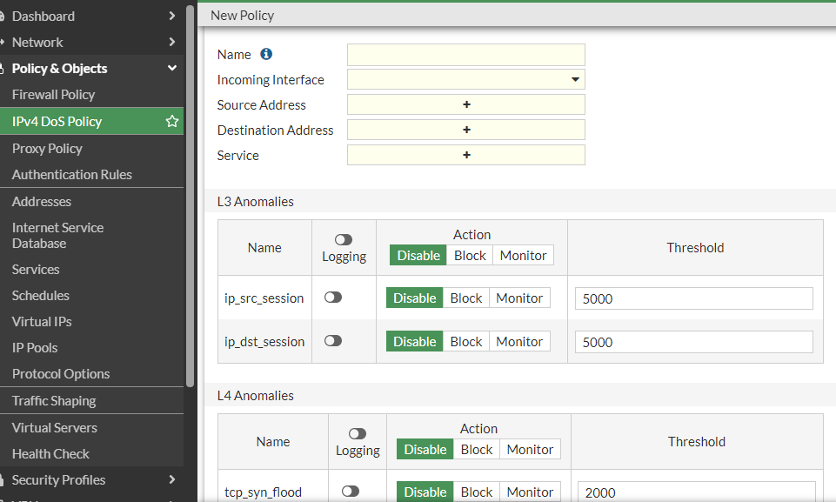
DOS Policy

Slide 67
